Slide 1
Part 2. Planning & Requirements
Matakuliah:
Datawarehouse & Datamining
Referensi:
Paulraj Ponniah, Data Warehousing Fundamenal for IT Profesional.

Slide 2
1. PERENCANAAN & PROJECT MANAGEMENT
Perencanaan
Fase Pengembangan
Tim Proyek
Faktor Kesuksesan

Slide 3
Perencanaan
List keuntungan nyata yang dapat diperoleh perusahaan → realistic benefit
Apa yang diharapkan dari adanya datawarehouse → expectations
Identifikasi resiko proyek → resiko yang mungkin terjadi, biaya proyek yang mungkin hilang dan cara mengurangi resiko.
Diskusikan pendekatan bottom-up atau top-down secara praktis
Build or Buy, seimbangkan antara pengembangan datawarehouse dalam perusahaan dengan vendor software yang digunakan.
Single vendor (all integrated) or Best-of-Breed (fit specific function)

Slide 4
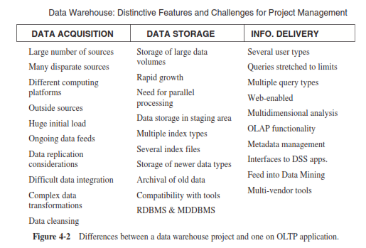
Fase Pengembangan
Notes:
At a very general level, a data warehouse is made up of these three broad components. You will notice that a data warehouse project differs from a project on OLTP application in each of these three functional areas.

Slide 5
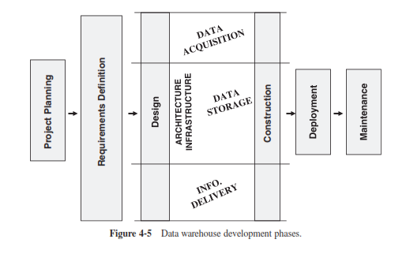
Fase Pengembangan
Notes:
The life cycle approach breaks down the project complexity is reason enough for
this approach to be considered for a data warehouse project. A data warehouse project is complex in terms of tasks, technologies, and team member roles.
The ﬁgure 4-5 shows the broad division of the project life cycle into the traditional phases:
† Project plan
† Requirements deﬁnition
† Design
† Construction
† Deployment
† Growth and maintenance
Each of the boxes shown in the diagram represents a major activity to be broken down further into individual tasks and assigned to the appropriate team members. Use the diagram as a guide for listing the activities and tasks for your data warehouse project. Although the major activities may remain the same for most warehouses, the individual tasks within each activity are likely to vary for your speciﬁc data warehouse.
In the development of every data warehouse, these tracks are present with varying sets of tasks. You may change and adapt the tasks to suit your speciﬁc requirements. You may want to emphasize one track more than the others. If data quality is a problem in your company, you need to pay special attention to the related phase.

Slide 6
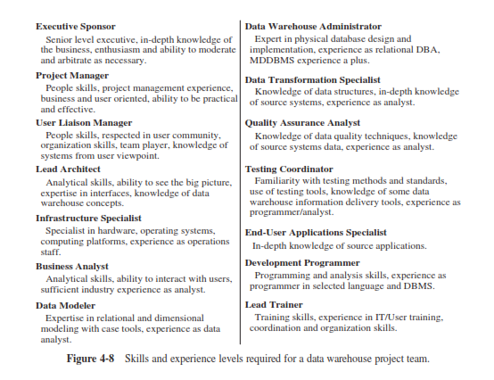
Tim Proyek
Notes:
When the implementation is complete, your users will begin to use the data warehouse directly with no mediation from IT. There is no predictability in the types of queries they will be running, the types of reports they will be requesting, or the types of analysis they will be performing. If there is one major difference between OLTP systems and data warehousing systems, it is in the usage of the system by the users.
What is the implication of this major difference in project team composition and data warehouse development? The implication is extremely consequential. What does this mean? This means that if the users will be using the data warehouse directly in unforeseen ways, they must have a strong voice in its development. They must be part of the project team all the way.
Gambar 4-8 menunjukkan peran dari masing-masing yang termasuk ke dalam tim proyek datawarehouse. Dimana setiap peran dengan tanggung jawabnya harus memiliki skill dan experience yang mendukung.

Slide 7
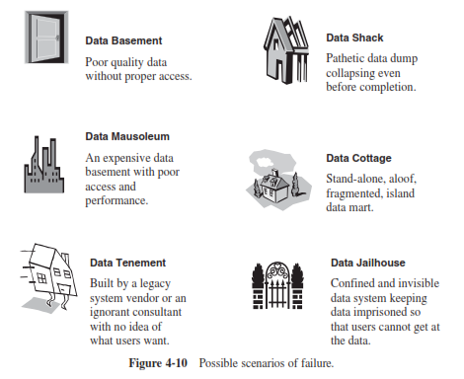
Possible scenarios of failure
Notes:
Data basement
Data dengan kualitas buruk dan akses yang salah
Data Maousoleum
Data yang mahal dengan performa dan kecepatan yang buruk
Data shack
Data hancur sebelum proses selesai
Data Tenement
Dibangun oleh warisan vendor lama atau konsultan yang kurang baik yang tidak sesuai dengan keinginan pengguna
Data cottage
Berdiri sendiri,terfragmentasi,pulau data mart
Data jailhouse
Sempit dan terpenjara sehingga pengguna tidak dapat mengambil data

Slide 8
2. DEFINISIKAN KEBUTUHAN BISNIS
Analisis Bisnis Secara Dimensional
Information Packages
Metode Pengumpulan Kebutuhan
Definisikan Kebutuhan (Scope, Content)

Slide 9
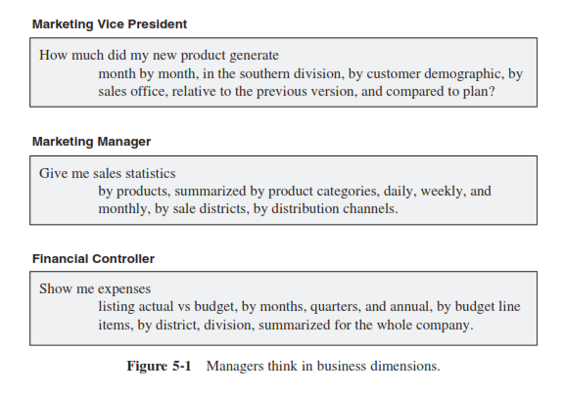
Analisis Bisnis Secara Dimensional
Penggunaan informasi bersifat unpredictable
Manajer berpikir secara dimensional
Notes:
Managers think of the business in terms of business dimensions. Figure 5-1 shows the
kinds of questions managers are likely to ask for decision making. The ﬁgure shows what questions a typical marketing vice president, a marketing manager, and a ﬁnancial controller may ask.

Slide 10
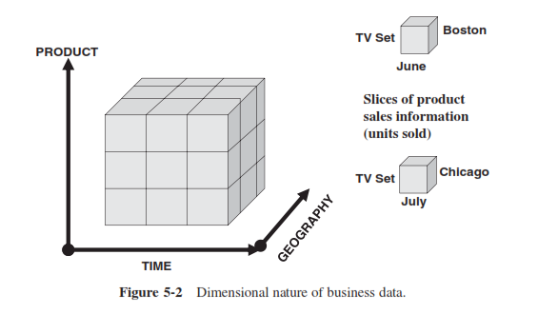
Analisis Bisnis Secara Dimensional
Notes:
Let us try to get a good grasp of the dimensional nature of business data. Figure 5-2 shows the analysis of sales units along the three business dimensions of product, time, and geography. These three dimensions are plotted against three axes of coordinates. You will see that the three dimensions form a collection of cubes. In each of the small dimensional cubes, you will ﬁnd the sales units for that particular slice of time, product, and geographical division. In this case, the business data of sales units is three dimensional because there are just three dimensions used in this analysis. If there are more than three dimensions, we extend the concept to multiple dimensions and visualize multidimensional cubes, also called hypercubes.

Slide 11
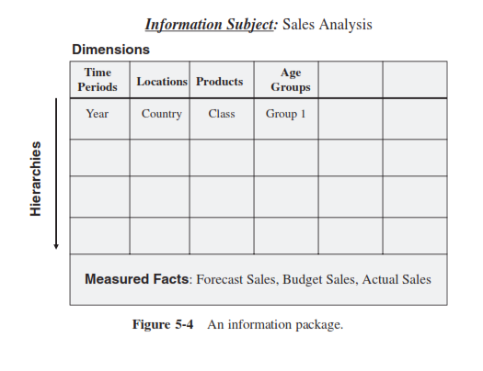
Information Packages
Pengguna tidak mampu mendeskripsikan secara penuh apa yang diharapkan untuk dilihat di datawarehouse, requirements not fully determinate.
Information packages merupakan bentuk pengumpulan informasi berdasarkan subyek
Notes:
Let us look at an information package for analyzing sales for a certain business.
Figure 5-4 contains such an information package. The subject here is sales. The measured facts or the measurements that are of interest for analysis are shown in the bottom section of the package diagram.
In this case, the measurements are actual sales, forecast sales, and budget sales. The
business dimensions along which these measurements are to be analyzed are shown at the top of the diagram as column headings.
n our example, these dimensions are time, location, product, and demographic age group. Each of these business dimensions contains a hierarchy or levels. For example, the time dimension has the hierarchy going from year down to the level of individual day. The other intermediary levels in the time dimension could be quarter, month, and week. These levels or hierarchical components are shown in the information package diagram.

Slide 12
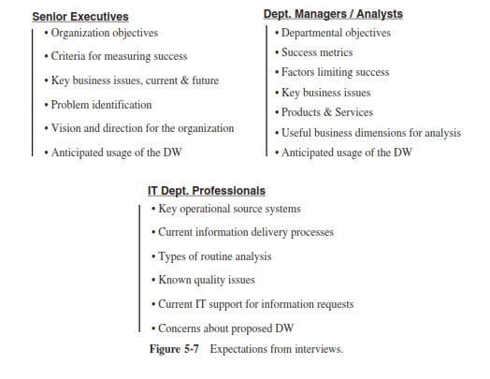
Pengumpulan Kebutuhan
Individual Interview
Notes:
Most of the users you will be interviewing fall into three broad categories:
senior executives, departmental managers/analysts, and IT department professionals.
What are the expectations from interviewing each of these categories? Figure 5-7 shows the baseline expectations.

Slide 13
Pengumpulan Kebutuhan
Group Session mengadaptasi metode JAD (Joint Application Development)
Mengumpulkan pengguna terkait untuk berdiskusi secara tersturtur dalam menentukan kebutuhan aplikasi.

Slide 14
Definisikan Kebutuhan
Document Outline:
Introduction
State the purpose and scope of the project. Include broad project justification. Provide an executive summary of each subsequent section.
General Requirements Descriptions
Describe the source systems reviewed. Include interview summaries. Broadly state what types of information requirements are needed in the data warehouse.
Specific Requirements
Include details of source data needed. List the data transformation and storage requirements. Describe the types of information delivery methods needed by the users.
Information Packages
Provide as much detail as possible for each information package. Include this in the form of package diagrams.
Other requirements
Cover miscellaneous requirements such as data extract frequencies, data loading methods, and locations to which information must be delivered.
User Expectations
State the expectations in terms of problems and opportunities. Indicate how the users expect to use the data warehouse.
User Participation and Sign-off
List the tasks and activities in which the users are expected to participate throughout the development life cycle.
General Implementation Plan
At this stage, give a high-level plan for implemenation
Notes:
Document Outline seperti project charter pada pengembangan perangkat lunak.
Dimana dokumen ini merupakan panduan untuk implementasi proyek.

Slide 15
3. KEBUTUHAN SEBAGAI DRIVING FORCE UNTUK DATAWAREHOUSE
Desain Data
Perencanaan Arsitektur
Spesifikasi Penyimpanan Data
Strategi Penyampaian Informasi

Slide 16
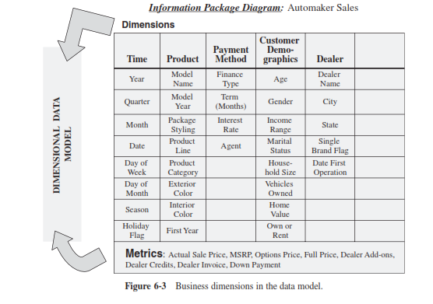
Desain Data
Dimensional Data Model
Level Detail Analisis:
Roll-up
Drill-down
Notes:
Setiap data dimensional dapat dilakukan roll-up dan drill-down untuk analisis.
Gambar menunjukkan contoh data model berbentuk dimensional dengan subyek sales.

Slide 17
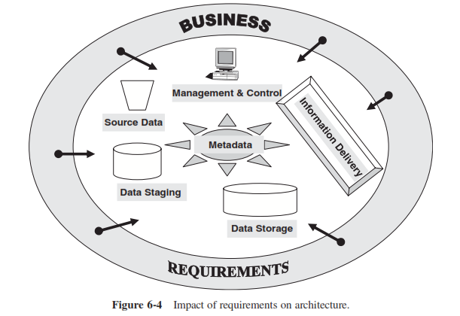
Perencanaan Arsitektur
Notes:
Gambar menunjukkan komponen umum dari arsitektur data warehouse.
Spesifikasi kebutuhan tiap komponen dipengaruhi oleh business requirement.
Again, remember that planning for the architecture involves the determination of the size and content of each component. In the following list, the bulleted points under each component indicate the type of information that must be contained in the requirements deﬁnition to drive the architectural plan.

Slide 18
Perencanaan Arsitektur
Informasi yang harus didefinisikan pada setiap komponen untuk membangun arsitektur datawarehouse:
Source Data
Operational source systems
Computing platforms, operating systems, databases, ﬁles
Departmental data such as ﬁles, documents, and spreadsheets
External data sources
Data Staging
Data mapping between data sources and staging area data structures
Data transformations
Data cleansing
Data integration
Notes:
Again, remember that planning for the architecture involves the determination of the size and content of each component. In the following list, the bulleted points under each component indicate the type of information that must be contained in the requirements deﬁnition to drive the architectural plan.

Slide 19
Perencanaan Arsitektur
Data Storage
Size of extracted and integrated data
DBMS features
Growth potential
Centralized for enterprise data warehouse
Data marts—conformed, dependent, independent, federated
Information Delivery
Types and number of users
Types of queries and reports
Classes of analysis
Dashboards/scorecards
Data mining operations
Front-end DSS applications
Notes:
Again, remember that planning for the architecture involves the determination of the size and content of each component. In the following list, the bulleted points under each component indicate the type of information that must be contained in the requirements deﬁnition to drive the architectural plan.

Slide 20
Perencanaan Arsitektur
Metadata
Operational metadata
ETL (data extraction, transformation, and loading) metadata
End-user metadata
Metadata storage
Management and Control
Data loading
External sources
Alert systems
End-user information delivery
Notes:
Again, remember that planning for the architecture involves the determination of the size and content of each component. In the following list, the bulleted points under each component indicate the type of information that must be contained in the requirements deﬁnition to drive the architectural plan.

Slide 21
Spesifikasi Penyimpanan Data
Estimasi ukuran penyimpanan data berdasarkan kebutuhan:
Data staging
Overal corporate data warehouse
Datamart
Multidimensional database
Notes:
While deﬁning requirements, bear in mind their inﬂuence on data storage speciﬁcations and collect all the necessary details about the back-end and the front-end architectural components.

Slide 22
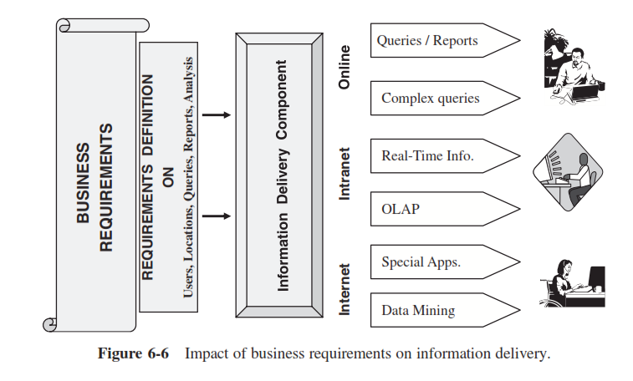
Strategi Penyampaian Informasi
Information Delivery Strategi bergantung pada kebutuhan bisnis
Notes:
A data warehouse exists for one reason and one reason alone — to provide strategic information to users. Information delivery tops the list of architectural components. Most of the other components are transparent to the users, but they see and experience what is made vailable to them in the information delivery component. The importance of business equirements relating to information delivery cannot be overemphasized.

