Slide 1
Information Package
The concept to gather requirement in DW

Slide 2
OLAP
Online Analytical Processing (OLAP), mengandung dua tipe data dasar (Mulyana, 2014):
Measures: data bilangan yang terukur misalkan kuantitas, harga, nilai rata-rata, jumlah dsb. → ada di tabel fakta
Dimension: kategori yang digunakan untuk mengatur measures, terdapat tingkatan (level). Misalnya dimensi waktu, dengan tingkatan tahun, kuartal, bulan dan hari. → ada di tabel dimensi

Slide 3
Information Package
Why?
Because the requirements of DW cannot be fully determined.
We have noted that the users tend to think in terms of business dimensions and analyze measurements along such business dimensions.
You come up with what is known as an information package for the speciﬁc subject.

Slide 4
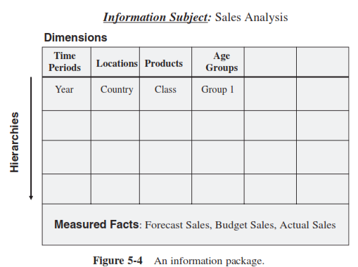
An Information Package For Analyzing Sales

Slide 5
Dimensions
A dimension is a structure that categorizes data in order to enable users to answer business questions.
Example of dimensions are customers, products, and time.

Slide 6
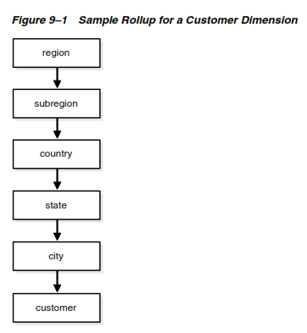
Hierarchy of Dimension
1:n relationships between the levels of a hierarchy.
Going up a level in the hierarchy is called rolling up and going down a level in the hierarchy is called drilling down.
Within the customer dimension, customers roll up to city. Then cities roll up to state. Then states roll up to country. Then countries roll up to subregion. Finally, subregions roll up to region.
Drill Down
Roll Up

Slide 7
Granularity
Granularity refers to the level of detail or summarization of the units of data in the data warehouse.
The more detail there is, the lower the level of granularity. The less detail there is, the higher the level of granularity.
For example, a simple transaction would be at a low level of granularity. A summary of all transactions for the month would be at a high level of granularity.

Slide 8
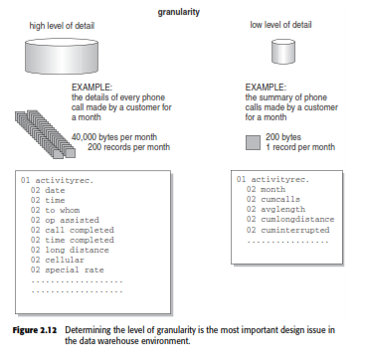
Granularity

Slide 9
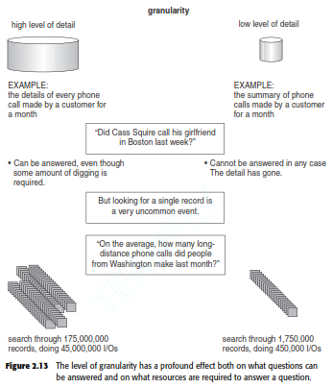
Granularity

Slide 10
Example of Hotel Occupancy
In this case, we want to come up with an information package for a hotel chain. The subject in this case is hotel occupancy.
We want to analyze occupancy of the rooms in the various branches of the hotel chain.
We want to analyze the occupancy by individual hotels and by room types. So, hotel and room type are critical business dimensions for the analysis.
As in the other case, we also need to include the time dimension.
In the hotel occupancy information package, the dimensions to be included are hotel, room type, and time.

Slide 11
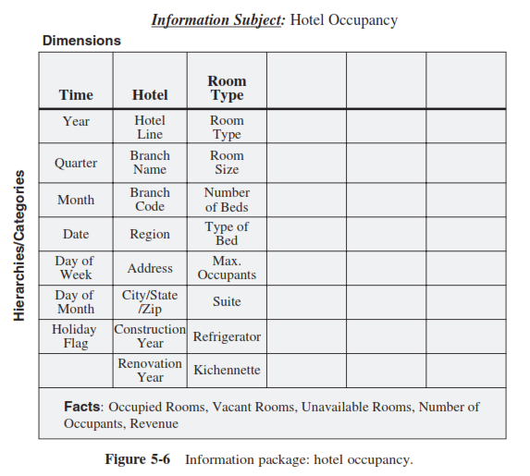
Information Package Diagram of Hotel Occupancy

Slide 12
The information package diagrams crystallize the information requirements for the data warehouse.
They contain the critical metrics measuring the performance of the business units, the business dimensions along which the metrics are analyzed, and the details of how drill-down and roll-up analyses are done.

Slide 13
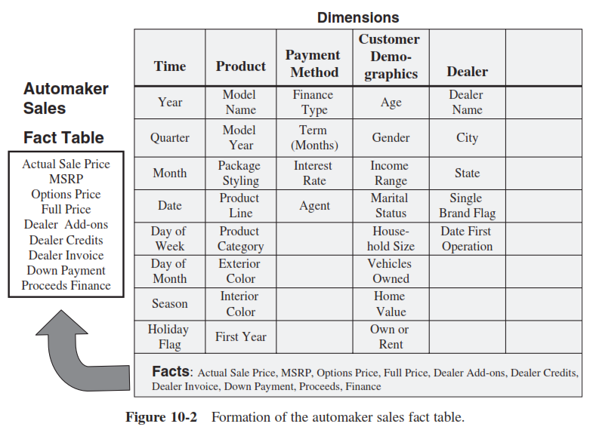
Information Package Diagram of Automaker Sales
Data pada facts dijadikan measurement pada database OLAP.
Data facts dijadikan field pada tabel fakta.

Slide 14
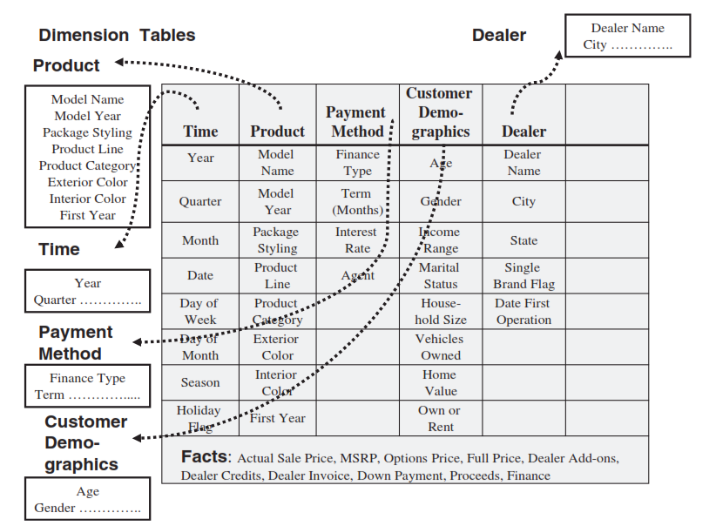
Information Package Diagram of Automaker Sales
Setiap dimensi dijadikan tabel dimensi yang berelasi dengan tabel fakta.
Tabel dimensi dapat dinormalisasi (snowflake) maupun tidak (star).

Slide 15
Referensi
Paulraj Ponniah
Oracle Data Warehouse Guide
Pentaho: Solusi Open Source untuk membangun Data Warehouse (Mulyana, 2014)

Slide 16
Tugas 2
BigBook, Inc. is a large book distributor with domestic and international distribution channels. The company orders from publishers and distributes publications to all the leading booksellers. Initially, you want to build a data warehouse to analyze shipments that are made from the company’s many warehouses. Determine the metrics or facts and the business dimensions. Draw an information package diagram.

